Slide 1
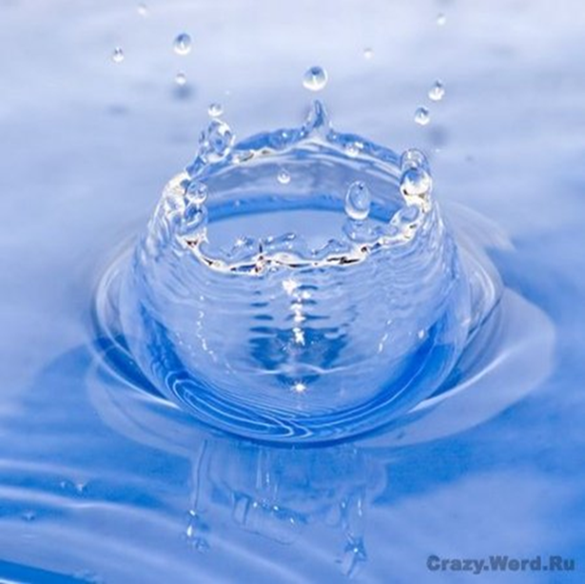
Hydrogeochemical methods of searches
Lecture 5
The composition of Ground Water

Slide 2
The composition of Ground Water
Academician VI Vernadsky believed that natural water is a complex aqueous solution. Groundwater include : macro- and micro-
elements, gases, organic substances, micro-organisms (living matter). Great importance are the isotopes of chemical elements of both the water and solutes. Currently, in the groundwater determined 85 chemical elements of Periodic table. That characterize the general chemical type of water, its properties, and have a particular scientific and practical importance.

Slide 3
Selected elements and examples of aquatic species
Although ground water is generally less susceptible to contamination восприимчивы к загрязнению than surface waters it is usually more highly mineralized in its natural state. As water moves slowly through the ground it can remain for extended длительный periods of time in contact with minerals present in the soil and bedrock and become saturated насыщаться with dissolved solids from these minerals. This dissolution process continues until chemical equilibrium is reached between the water and the minerals with which it is in contact. Important mineral constituents found in ground water and their relative abundance are listed in Table

Slide 4
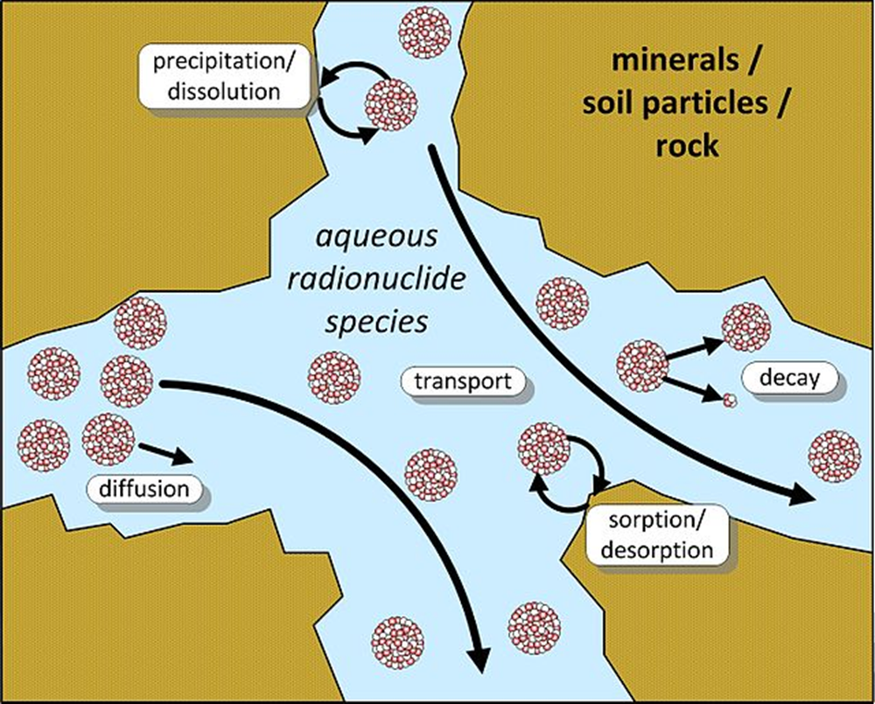
water moves

Slide 5
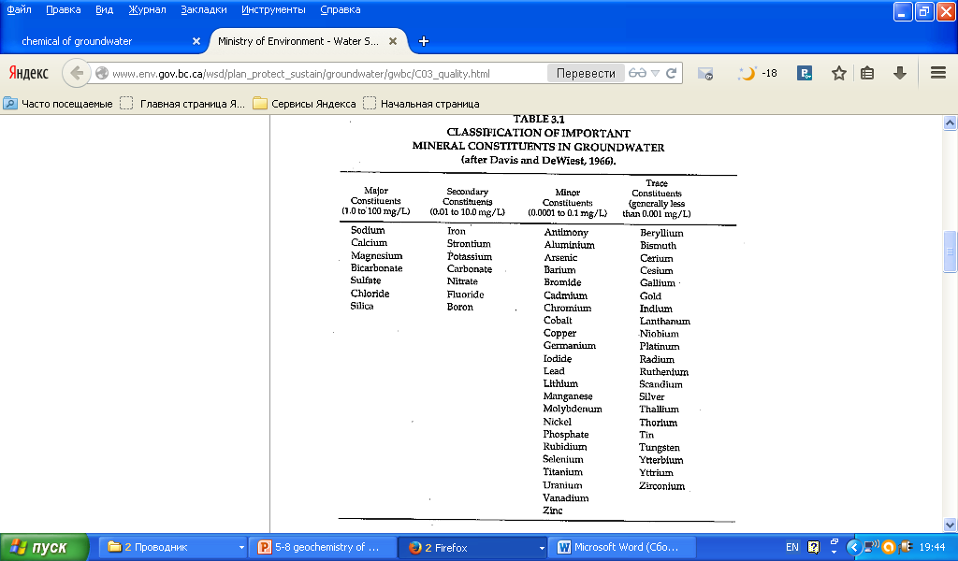

Slide 6
Selected elements and examples of aquatic species
The types and relative относительные concentrations of the chemical constituents in ground water provide information on the evolution of ground waters, age (residence time), solubility, rates скорость of movement, flow history and sources of recharge. Older ground waters for example are generally more mineralized than younger ground waters. Fresher ground waters are normally associated with recharge areas области питания where as ground waters in discharge areas –область разгрузки are more mineralized. Ground waters can be classified according to the most dominant percentage of cations and anions being present based on concentrations in equivalents per million [epm] (e.g., calcium-magnesium bicarbonate type).

Slide 7
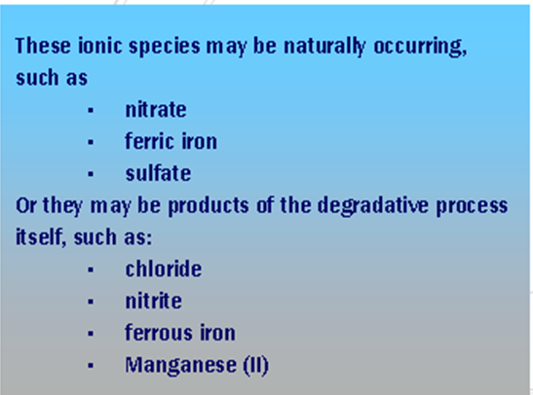
Selected inorganic elements and examples of aquatic species
There are a group of ionic species видов in groundwater
whose concentration is also useful in characterizing
chemical and biological degradative processes

Slide 8
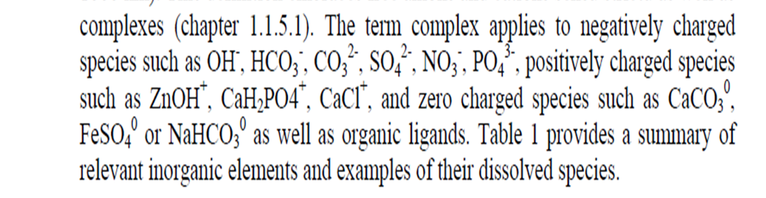
Selected inorganic elements and examples of aquatic species
Chemical reactions determine occurrence определяет возникновение, distribution распространение , and behavior поведение of aquatic species in water. The aquatic species is defined определяются as organic and inorganic substances dissolved in water in contrast to colloids (1-1000 nm) and particles (> 1000 nm). This definition embraces включает free anions and cations and its complexes. The term complex applies относится to negatively charged-заряженным

Slide 9
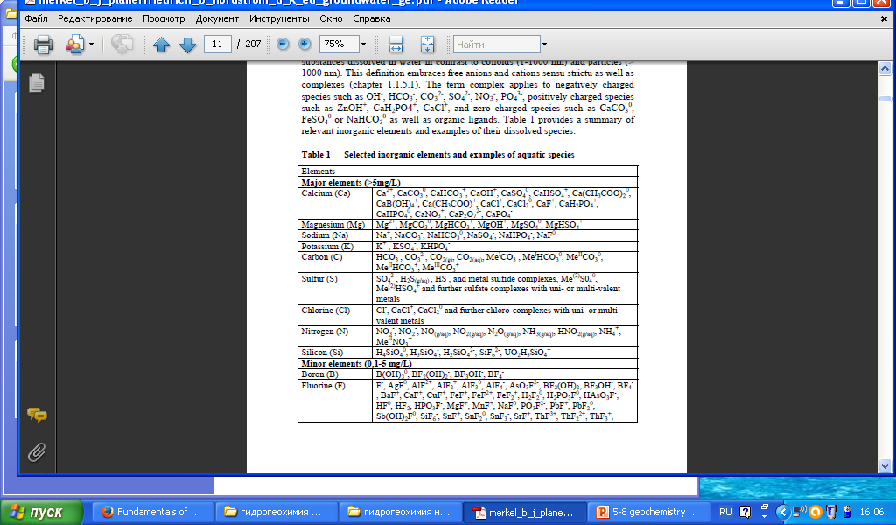

Slide 10
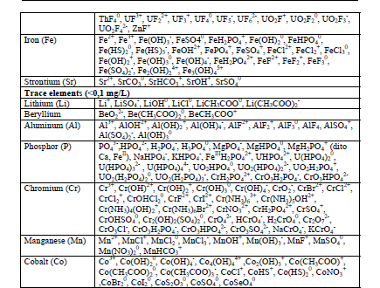

Slide 11
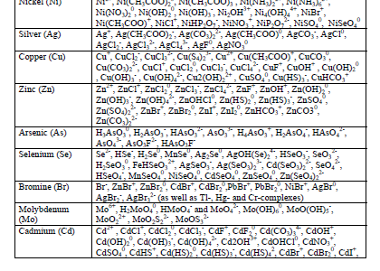

Slide 12
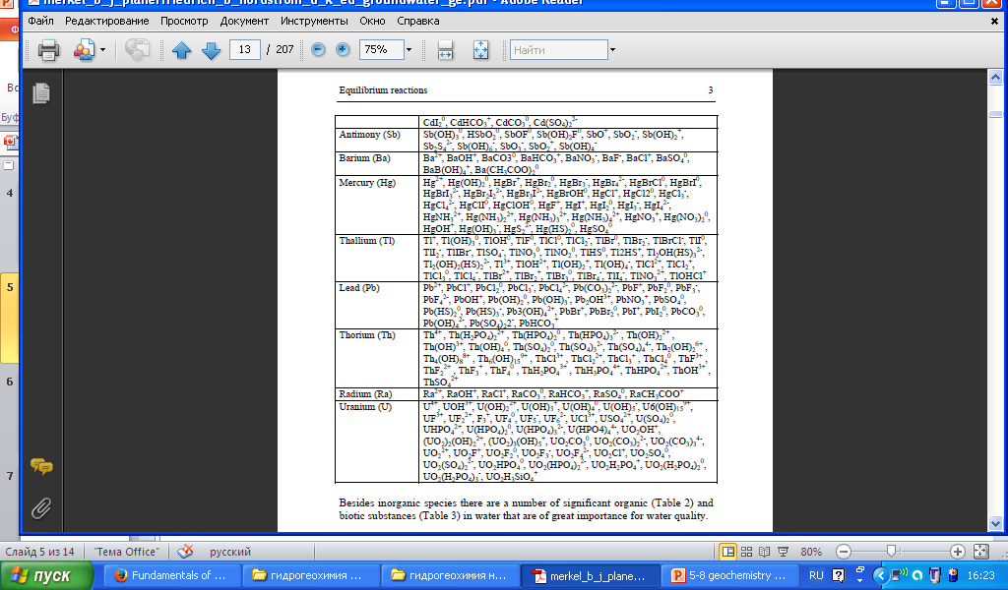

Slide 13
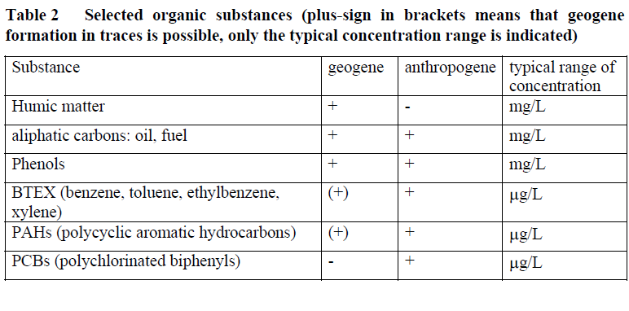
Selected organic substances

Slide 14
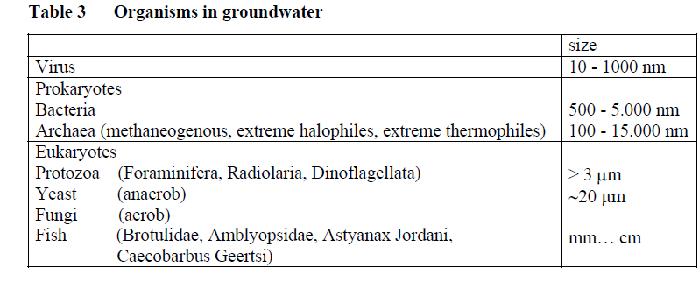
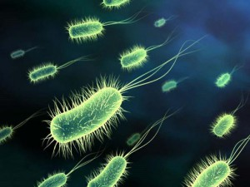
Organisms in groundwater

Slide 15
Dissolved gas species
Gases and water are in constant exchange: natural water - Natural gas. Distinguish adsorbed, dissolved and free gases.
By origin there are gases: air (N2, O2, CO2, Ne, Ar), biochemical (CH4, CO2, H2S, H2), chemical (CO2, H2S, CO, N2, HCl), and gases of nuclear reactions (Не, Rn). Air gases penetrate into lithosphere from the air. Biochemical gases formed during the decomposition of microorganisms substances. Chemical gases formed by the interaction of water and rock.

Slide 16
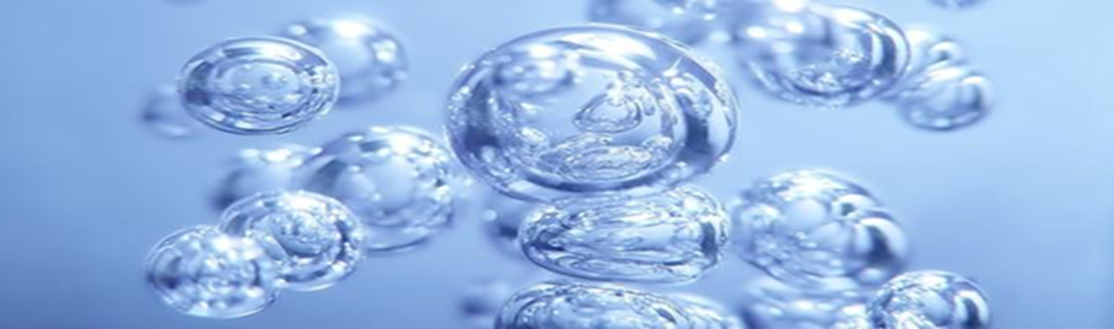
Dissolved gas species
Nuclear reaction gases are formed as a result of radioactive decay and the formation of subsidiaries gaseous isotopes.
The gases dissolved in the water, and when conditions change stand out. Gases at certain concentrations are toxic.

Slide 17
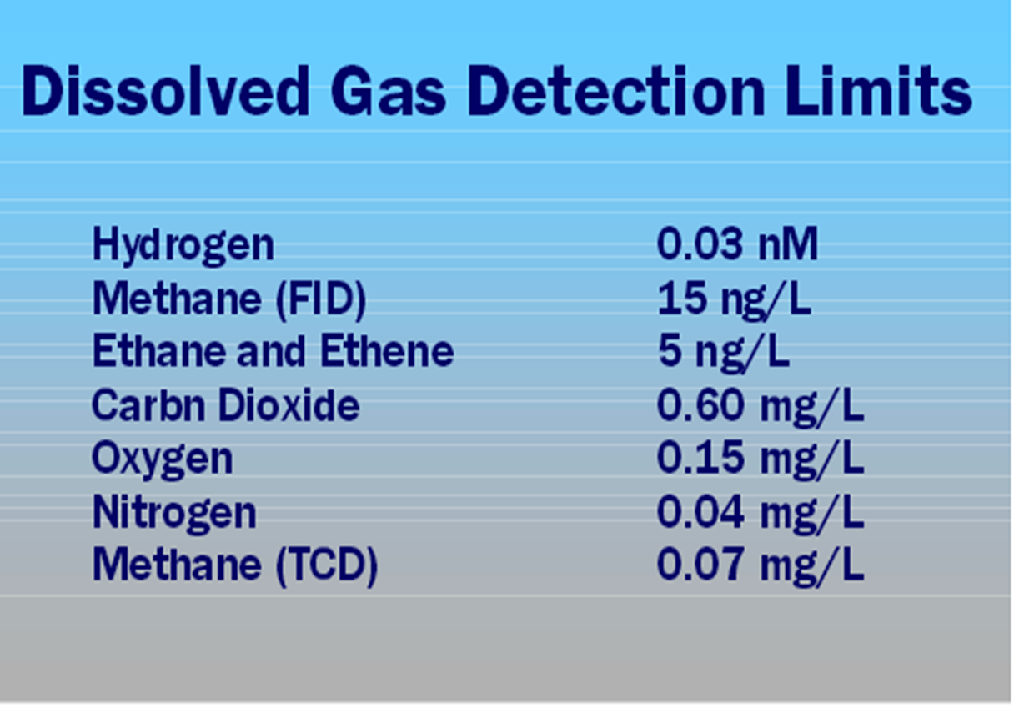
Antropogenic dissolved gas species
Both abiotic and biologically facilitated reactions in groundwater often produce species that exist in groundwater as dissolved gases. Typical dissolved gas species are carbon dioxide, methane, ethene, ethane, hydrogen, and acetylene.

Slide 18
The isotopic composition
Isotopes are varieties of the same chemical element that differ from each other by mass of atoms. There are stable and radioactive isotopes of chemical elements (as the water itself H and O), and macro- and micro.
The most frequently occurring are stable isotopes of hydrogen (1H, 2H), oxygen (16O, 1Smilie: 8O), carbon (12C, 13C), sulfur (32S), helium (3He), argon (36 Ar).

Slide 19
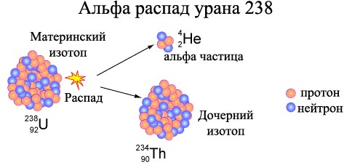
Radioactive isotopes

Slide 20
Hydrogeochemical methods of searches
Lecture 6
Migration of Elements

Slide 21
Migration of Elements
Migration of Elements is the movement and redistribution of chemical elements in the earth’s crust and on its surface. The term was introduced by A. E. Fersman in 1923.

Slide 22
The Form of Migration
Migration of elements may take place in the liquid phase (in melts, hydrothermal solutions, and subterranean грунтовых and surface water), in the gaseous phase (with volcanic gases and fumaroles, and gases from mineral sources, petroleum deposits, and decaying разлагающихся organic compounds), and in the solid phase (as a result of diffusion and recrystallization).

Slide 23
The Form of Migration
Migration in solid form takes place mainly on a mechanical basis (for example, taluses осыпи and flows of water and dust – пыль ). In aqueous solutions, elements migrate in the form of ions, molecules, and colloidal particles; in gases they move as molecules and aerosols.

Slide 24
The ability to migrate (conditions)
The ability to migrate differs in different elements; it depends on the nature of the chemical compounds and on the physicochemical conditions under which the elements migrate.
The out-washing and dispersion of certain chemical elements and the accumulation of others, which often produces commercial deposits, take place as a result of the migration of elements.
Intensive migration of elements is observed during the processes of metasomatism and chemical differentiation in marine bodies of water

Slide 25
The ability to migrate (conditions)
Biogeochemical processes play a major role in the migration of elements that takes place under the influence of external внешних processes.
Methods of geochemical mineral prospecting are based on the regularities of the migration of elements

Slide 26
Migration factors
Migration factors are divided into internal and external. Internal factors - factors that related only to the properties of atoms and their compounds, they include:
1. The connection properties, including physical concentration of substances;
2. Chemical properties or the ability of atoms and compounds to chemical reactions;
3. Energy and the chemical -crystallization properties of substances;
4. Gravitational factor associated with atomic mass;
5. The radioactive properties of atoms.

Slide 27
Migration factors
External factors are determined by the environment, do not depend on the individual properties of the migration of substances

Slide 28
Mechanical migration
Mechanical migration (mehanogenez) is due to the work of rivers, streams, wind, glaciers, volcanoes, tectonic forces and other factors.

Slide 29
Physical and chemical migration.
Diffusion
The simplest form of physical and chemical migration - diffusion - a process of self-arbitrary and irreversible transfer of matter from one part of the system to another, which is caused by the thermal motion of the particles. Rocks are heterogeneous systems, enclosing solutions and / or gases that interact with it. In nature are typically diffused through a series of layers with dissimilar different diffusion coefficient. Thus on its passage can affect the porosity of the medium, its structure and rock moisture stratification.

Slide 30
Convection
Interconnecting смежный diffusion process - convection - migration of mass flows of gas or liquid, the particles move with the solvent occurs. Convection is typical for the upper mantle and crustal. Convection in a porous medium is called filtering, which is considerably faster than diffusion and particularly characteristic of the upper crust - the zone of active water exchange, although it may develop in the depths of the earth.

Slide 31
Sorption
Another form of migration - sorption. In this process, the absorption of gases or liquids, solids or liquids from the environment surface (adsorption), or all of the volume (absorption) of the body. Absorbing substances are called adsorbents (absorbent) and absorbed adsorbates (absorbate).

Slide 32
Forms of migration of chemical elements in water
In natural waters, the chemical elements and their compounds migrate ionic colloid suspended (suspensions of organic and inorganic substances, organic and mineral), a gaseous form, but also living organisms (plants, animals, bacteria). For natural waters are characterized ionic form of migration of chemical elements

